Slide 1
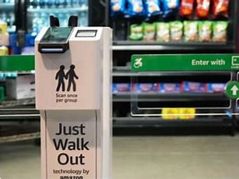
Just Walk Out
The Future of Retail
James Thornburg
BPS 415

Slide 2
Just Walk Out..
What is it?
Uses AI, computer vision, and shelf sensors to detect what customers pick up
Links items to the customer’s Amazon account or payment method
Allows shoppers to enter, take items, and leave without checking out
Automatically charges customers after they exit

Slide 3

Customers:
Waiting in long lines
Managing Payments
Retailer:
Unable to get customers in and out
High theft and inventory shortage

Slide 4
Solution
Customers:
Being able to walk right out without waiting in lines
Having your choice of payment already connected
Retailer:
No cashier systems allowing more people in and out
Utilize cameras and shelf sensors to track items.

Slide 5
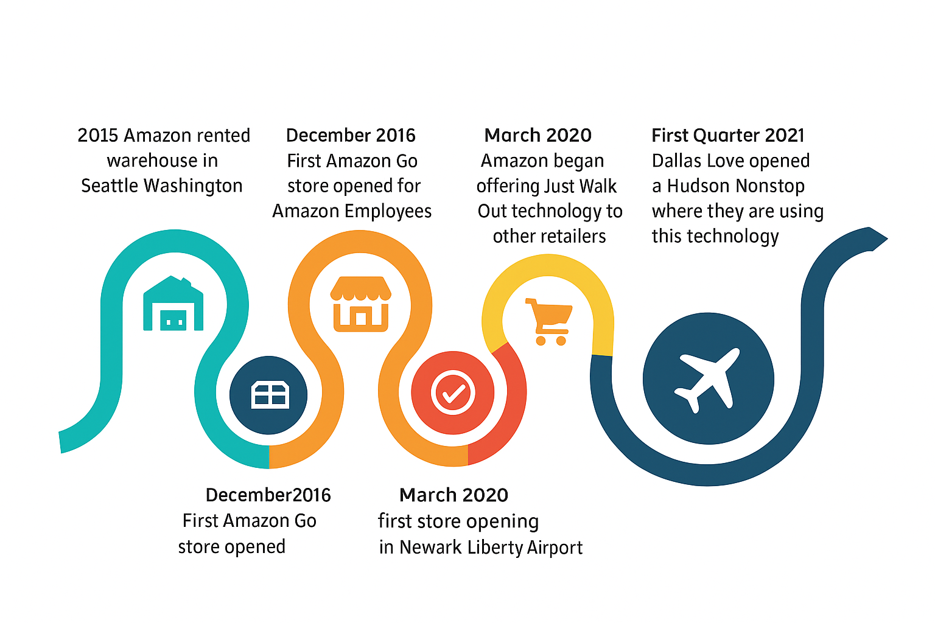
TIMELINE

Slide 6
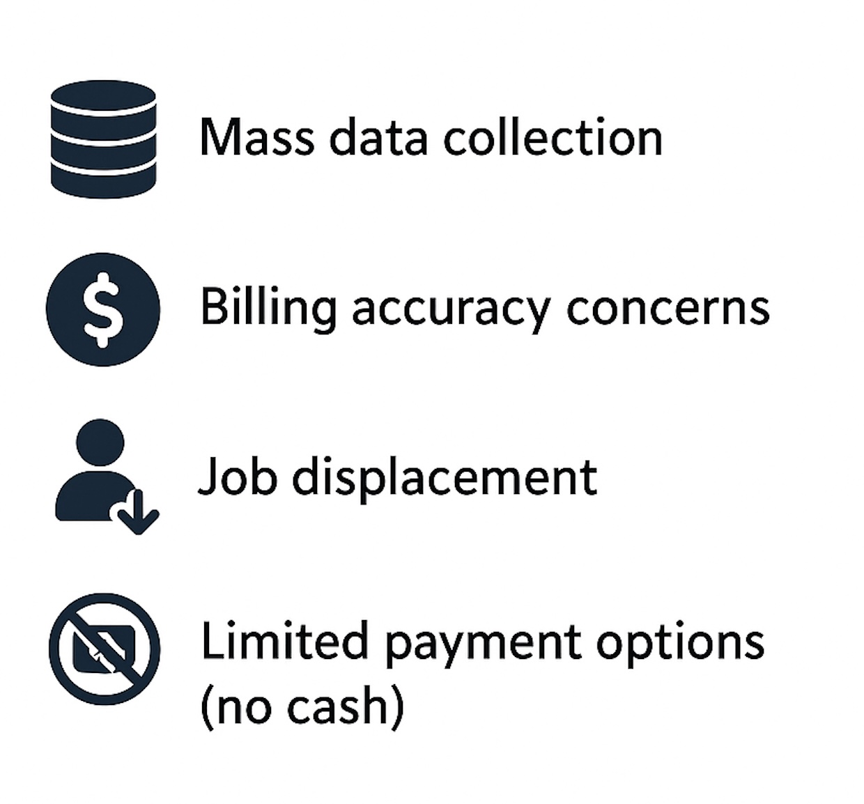
Concerns

Slide 7
Questions

Slide 8
References
Amazon. (2020). How Just Walk Out technology works. Amazon. https://www.amazon.com/just-walk-out
Amazon. (2023). Just Walk Out locations: Stadiums, airports, and retailers using Amazon’s technology.
https://www.aboutamazon.com/news/retail/amazon-just-walk-locations
Palmer, A. (2020, March 9). Amazon is selling cashierless checkout technology to other retailers. CNBC.
https://www.cnbc.com/2020/03/09/amazon-selling-cashierless-checkout-technology-to-other-retailers.html
Reyes, L. (2023, March 16). Amazon accused of not telling New York City customers about biometric tracking in Amazon Go stores. CBS News.
https://www.cbsnews.com/news/amazon-go-stores-new-york-city-lawsuit-biometric-tracking/
Stieg, C. (2023, March 16). Amazon stores collect biometric data without customers knowing, lawsuit argues. Business Insider.
https://www.businessinsider.com/amazon-stores-collect-data-customer-lawsuit-argues-2023-3
Thompson, D. (2018, January 22). At Amazon’s checkout-free store, shopping feels like shoplifting. The Atlantic.
https://www.theatlantic.com/business/archive/2018/01/amazon-go-store-checkouts-seattle/551357/

